Slide 1
Efficient Document Filtering Using Vector Space Topic Expansion and Pattern-Mining The Case of Event Detection in Microposts
Speaker: Jim-An Tsai
Advisor: Professor Jia-ling Koh
Author: Julia Proskurnia，Ruslan Mavlyutov，Carlos Castillo
Date: 2017/12/12
Source: CIKM ’17

Slide 2
Outline
Introduction
Method
Experiment
Conclusion

Slide 3
Motivation

Slide 4
Motivation
Notes:
計算上昂貴+poor Recall

Slide 5
Motivation
Notes:
特定領域 代表性不足

Slide 6
Motivation
Notes:
計算昂貴。兩個文本間需要準確的相似度，需要大量已標記好的資料

Slide 7
Purpose
Propose a method
1. more efficient
2. more accurate
3. achieve high performance even with very small training data

Slide 8
Outline
Introduction
Method
Experiment
Conclusion

Slide 9
Framework

Slide 10
Data Collection
Notes:
伊拉克
以色列
尼日利亞
阿富汗
巴基斯坦
埃及
也門
敘利亞
索馬里
喀麥隆

Slide 11
Seed Extraction

Slide 12
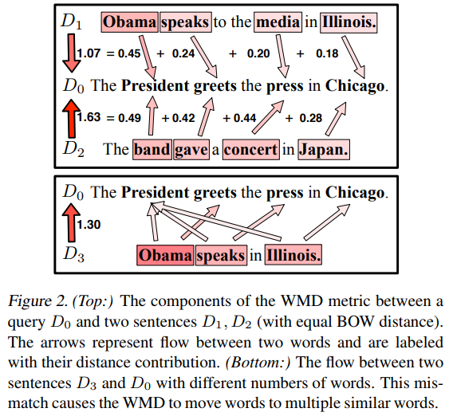
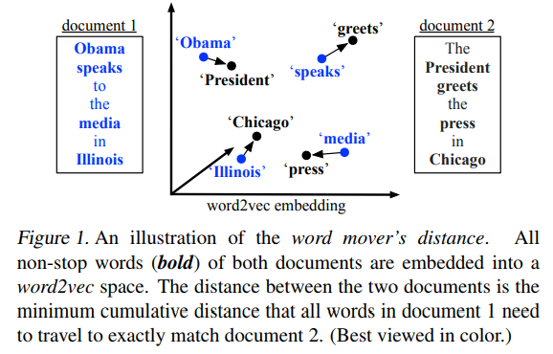
Text similarity metric
WMD
Notes:
算WMD是為了要去確認 Doucument是否含有itemset，並且是topically related

Slide 13
Text similarity metric

Slide 14
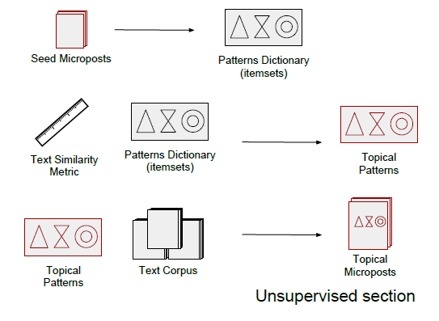
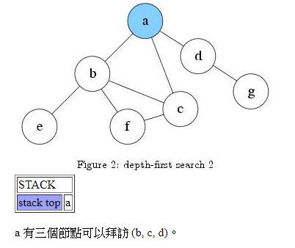
Pattern extraction

Slide 15
Result

Slide 16
Outline
Introduction
Method
Experiment
Conclusion

Slide 17
Experiment

Slide 18
Outline
Introduction
Method
Experiment
Conclusion

Slide 19
Conclusion
we introduced a generic and flexible framework for semantic filtering of microposts.
Our framework processes microposts by combining two key features: semantic pattern mining and document similarity estimation based on the extracted patterns.

